Slide 7
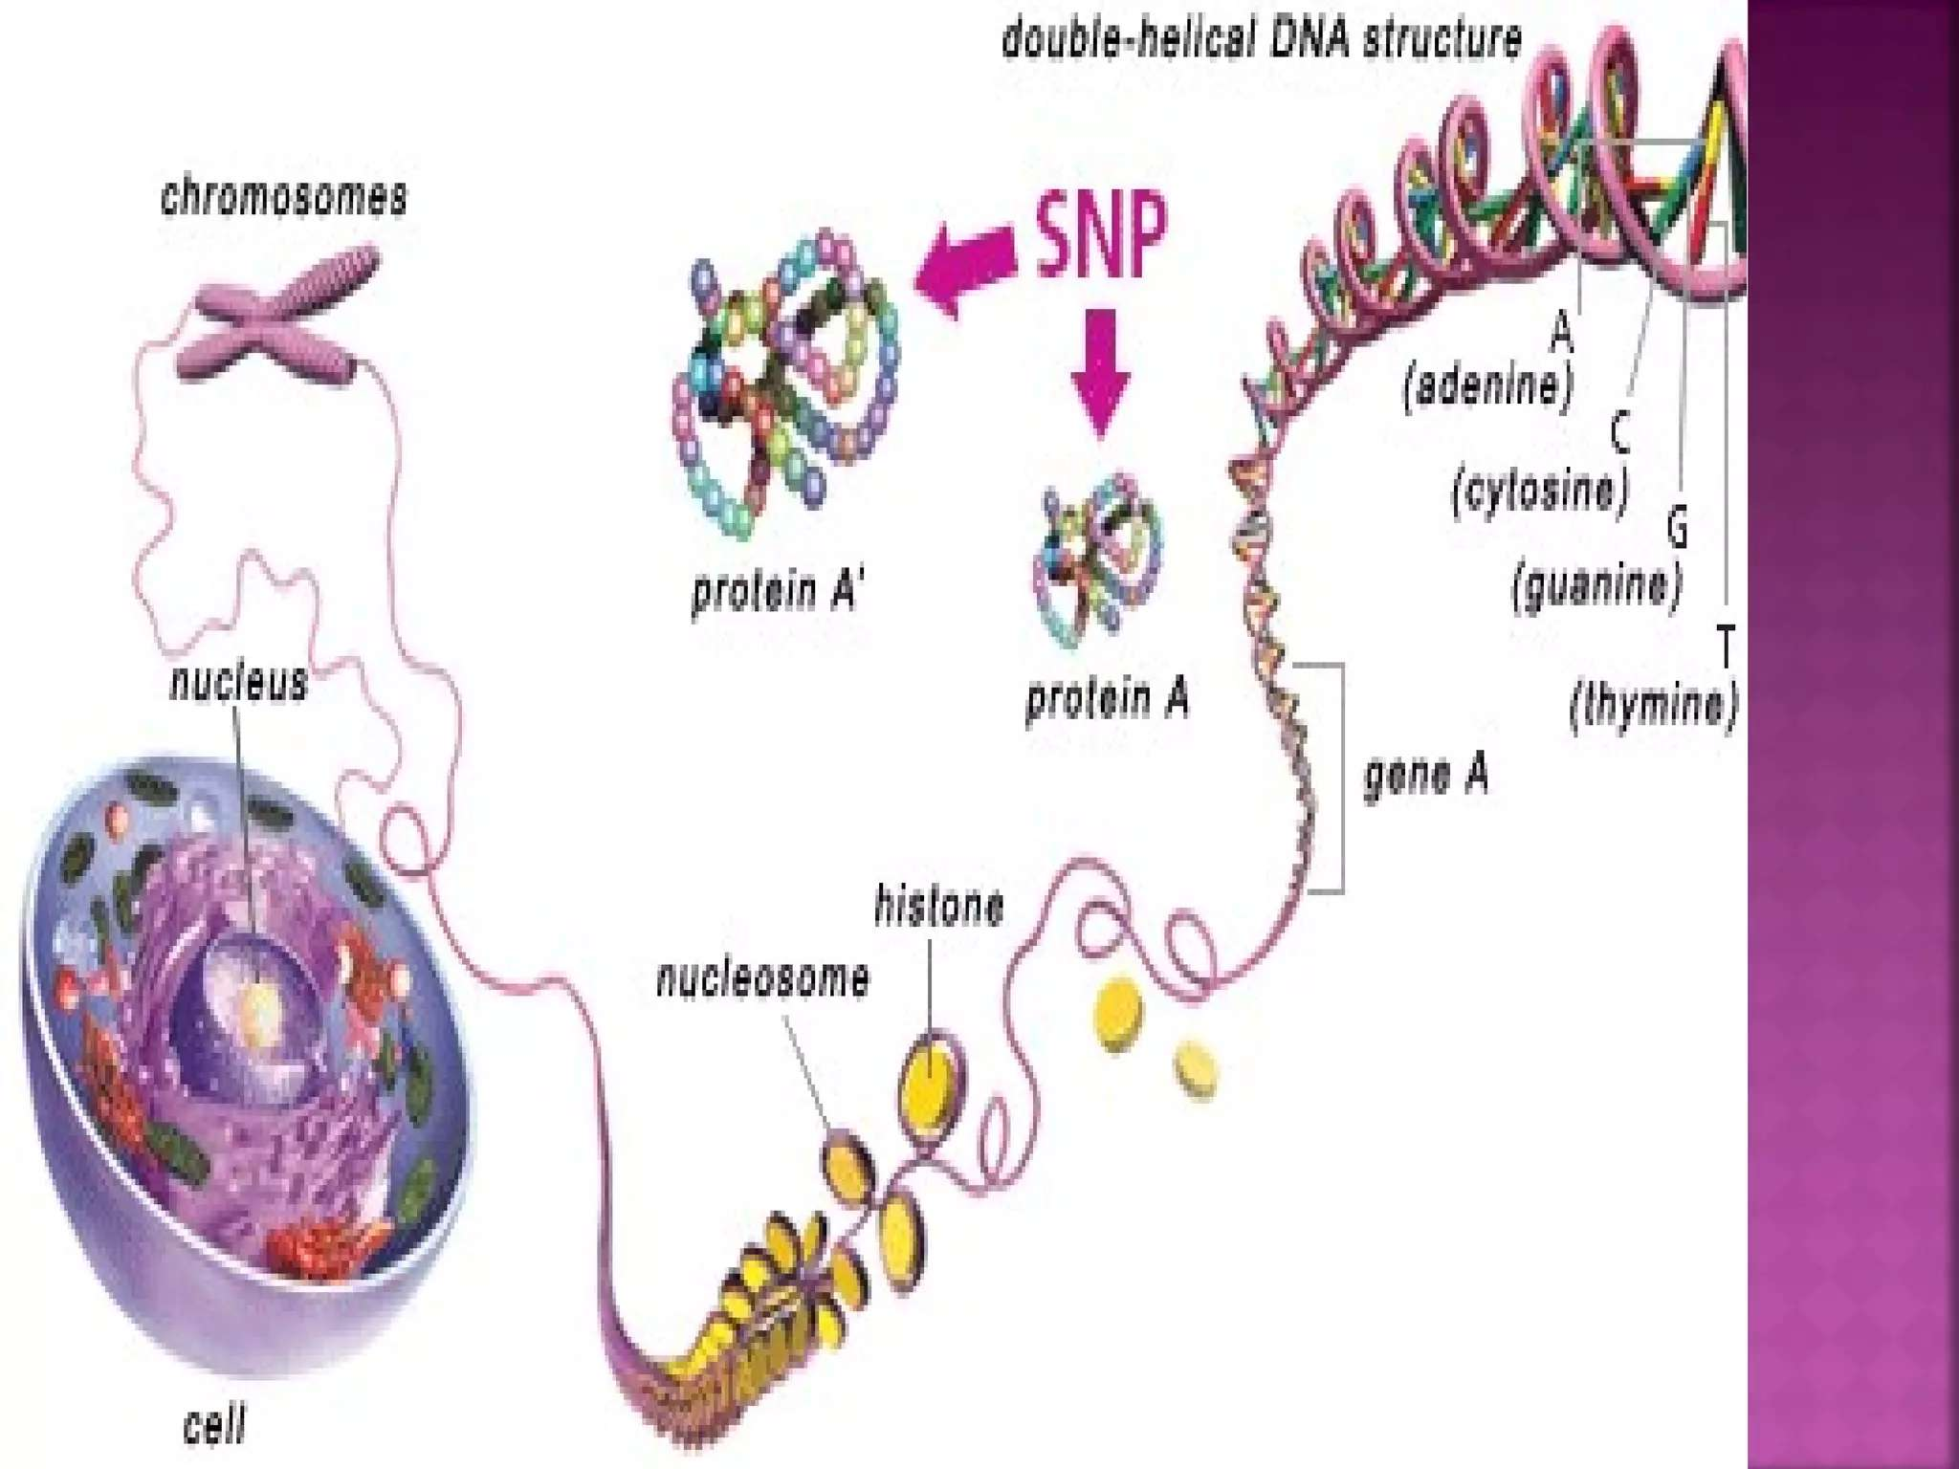

Slide 23
ONE GENE ONE ENZYME CONCEPT -
Given by Beadle and Tatum, during discovery of biochemical mutation in Neurospora crassa.
all the biochemical processes are controlled by genes in all organism.
Each and every step of any reaction controlled by gene, so the ration between gene and biochemical reaction is 1:1.
If one gene mutated, then only one step of process will be affected, not whole process.
On the basis of above observation, Beadle and Tatum suggested that, “Every gene controls the formation and function of an enzyme”.

Slide 24
2. ONE GENE ONE POLYPEPTIDE CONCEPT –
After many discoveries, its proved that, most of the enzyme like, heamoglobin made by two or more polypeptide chains and each polypeptide chain is the production of different genes.
E.g. – tryptophan synthatase enzyme in E. coli, is made up of two polypeptide chain –
α – polypeptide chain – coded by trp – A gene
β – polypeptide chain – coded by trp – B gene
THEN, INGRAM told that “each gene code for a single polypeptide chain not for a whole protein or enzyme”.

